Slide 1

Agentic AI Builder: Low-Code AI Agents & Voice Agents in n8n
Week 3
Day 4

Slide 2
3 Weeks to Agentic AI Builder
Core skills
Integrations
Projects
Week 3: Amplify with multi-agent systems and MCP
Self-hosted n8n and Local LLMs
Advanced Integrations
MCP
Context Engineering, Sub-Agents
Capstone: Amplify your business
Week 2: Accelerate with Voice Agents and RAG
Voice Agents with ElevenLabs
Integrating ElevenLabs and n8n
RAG and Agentic RAG
Supabase Vectors and Data ingest
Product Expert Voice Agent
Week 1: Automate with workflows in n8n cloud
First n8n AI Agent Live
Foundations: Agentic AI and n8n
Integrations with docs and email
Data and integrations
Daily Portfolio Rebalancer

Slide 3
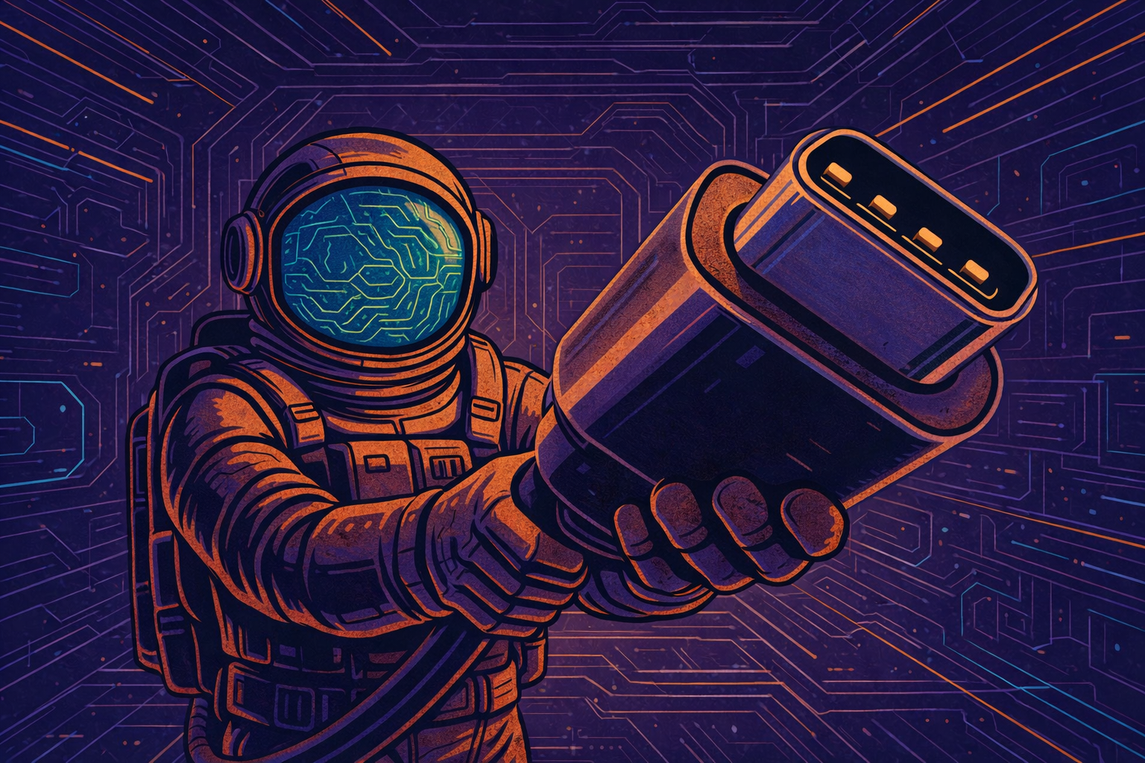
So, what is MCP?
Model Context Protocol from Anthropic
“The usb-c port for AI applications”
“an open-source standard for connecting AI applications to external systems”

Slide 4
The two ways to use MCP
An easy way to use someone else’s tool
We made use of Firecrawl and Hunter.io tools via MCP
To be precise: we created MCP Client Nodes that connected to the Firecrawl and Hunter.io MCP Server nodes
An easy way to share a tool
We turned our entire Prospecting sub-agent into a tool which we made available as an MCP Server
We created an MCP Server Trigger and we connected it to the Claude Chat app

Slide 5
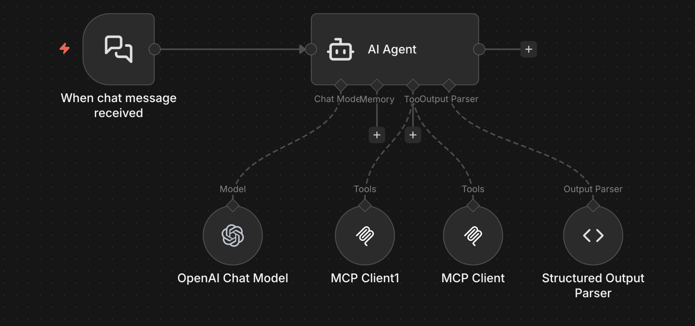
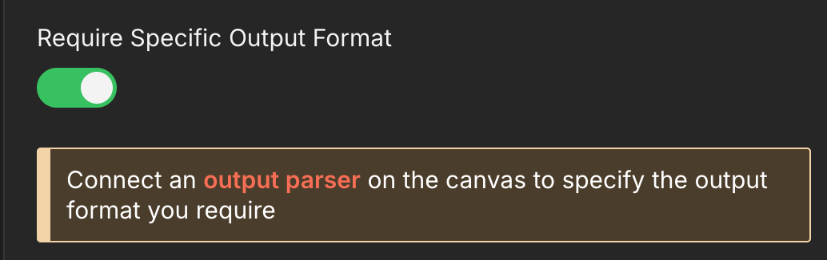
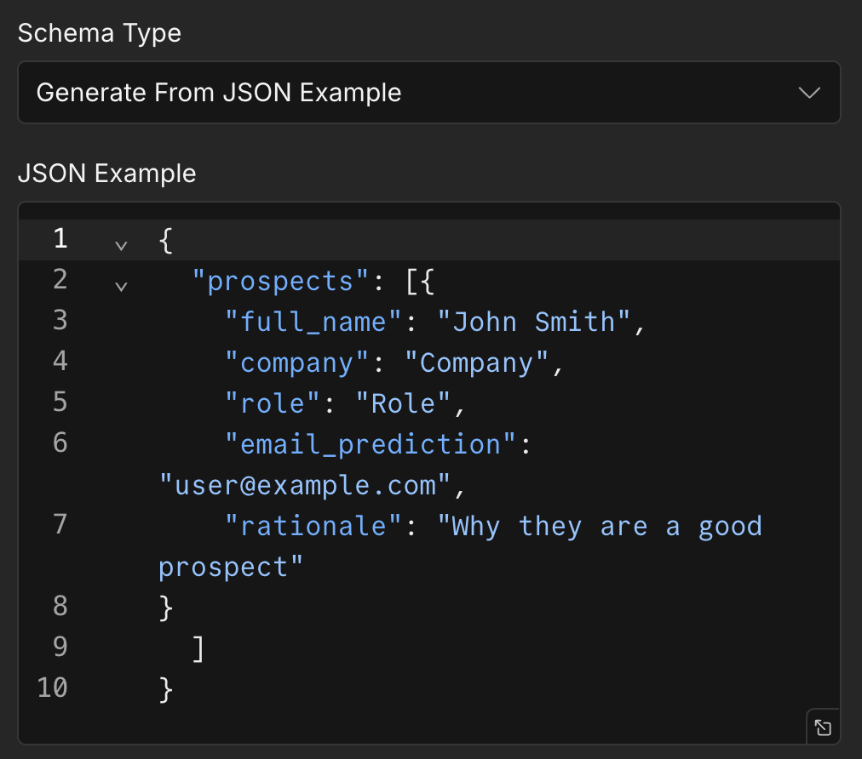
Recap: Structured Outputs
Often either Tools or Structured Outputs can be used to achieve the same business goal.
Structured Outputs is the ‘boring but bullet-proof’ choice.

Slide 6



THE SUCCESSOR TO PROMPT ENGINEERING:
The new skill is
Context Engineering
LLMs can only process a limited size of input
The ‘context window’ includes all the conversation so far
More tools gives more flexibility but takes space
The model can lose coherence resulting in unreliable outcomes
Context Engineering is the art of fitting it in perfectly
The best selection of prompts, tools and structured outputs for the goal

Slide 7
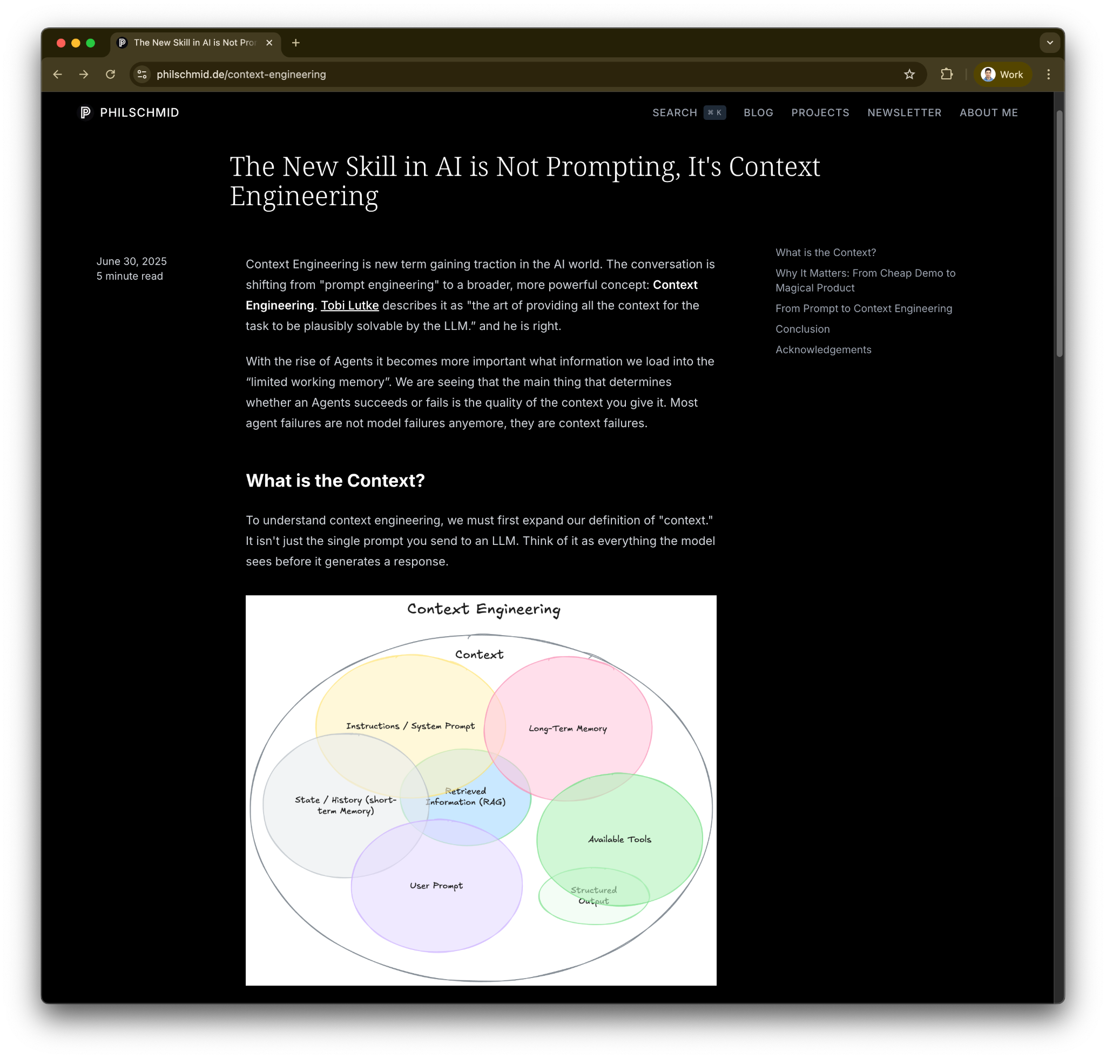

Slide 8
A CORE AGENTIC AI PATTERN
Sub-Agents
Divide into smaller, independently testable steps
Good for reuse - share the same sub-agent
Optimizes context window
Easily implemented in n8n with sub-workflows
Beware the Trap! Don’t anthropomorphize
Reduces Autonomy; the model has less flexibility on how to tackle problems
Typically, more to build! (But easier to test)

Slide 9
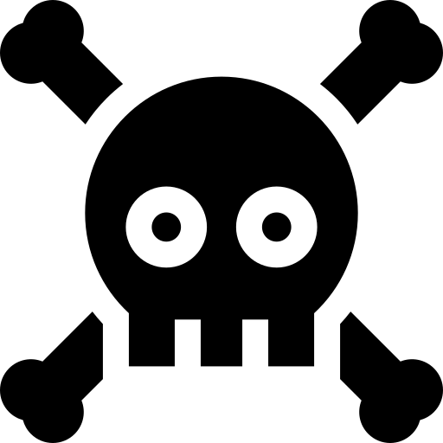
The crucial security term coined by Simon Willison:
The “Lethal Trifecta”
Access to
private data
Ability to
communicate
externally
Exposure to
untrusted
content

Slide 10
EVALS!
The hallmarks of a strong
Agentic solution
An anti-pattern is The Trap / anthroporphizing
Another red flag is being overly solution focused: I need an Agent for X
And another is taking generated content as the goal: “Provide a business strategy for X”
A clearly identifiable business problem
A metric to evaluate with established success criteria
Rigorous testing to demonstrate criteria met

Slide 11

Capstone: Amplify Your Business

Slide 12
Capstone: Amplify Your Business
Applicable to all businesses, agencies and yourself!
An Agentic solution to generate new business
Many opportunities to extend
AGENT 1: Outbound Sales
Business Development Manager
Prospecting sub-agent
Prospecting sub-agent
RevOps sub-agent
SDR
sub-agent

Slide 13
3 Weeks to Agentic AI Builder
Core skills
Integrations
Projects
Week 3: Amplify with multi-agent systems and MCP
Self-hosted n8n and Local LLMs
Advanced Integrations
MCP
Context Engineering, Sub-Agents
Capstone: Amplify your business
Week 2: Accelerate with Voice Agents and RAG
Voice Agents with ElevenLabs
Integrating ElevenLabs and n8n
RAG and Agentic RAG
Supabase Vectors and Data ingest
Product Expert Voice Agent
Week 1: Automate with workflows in n8n cloud
First n8n AI Agent Live
Foundations: Agentic AI and n8n
Integrations with docs and email
Data and integrations
Daily Portfolio Rebalancer

Slide 14

Agentic AI Builder: Low-Code AI Agents & Voice Agents in n8n
93%
Complete

